Slide 1
Report on
Customer Sales Analysis

Slide 2
Objective
To build a dashboard that will present monthly sales performance by product segment and product category to help client identifying the segments and categories that have met or exceeded their sales targets, as well as those that have not met their sales targets.

Slide 3
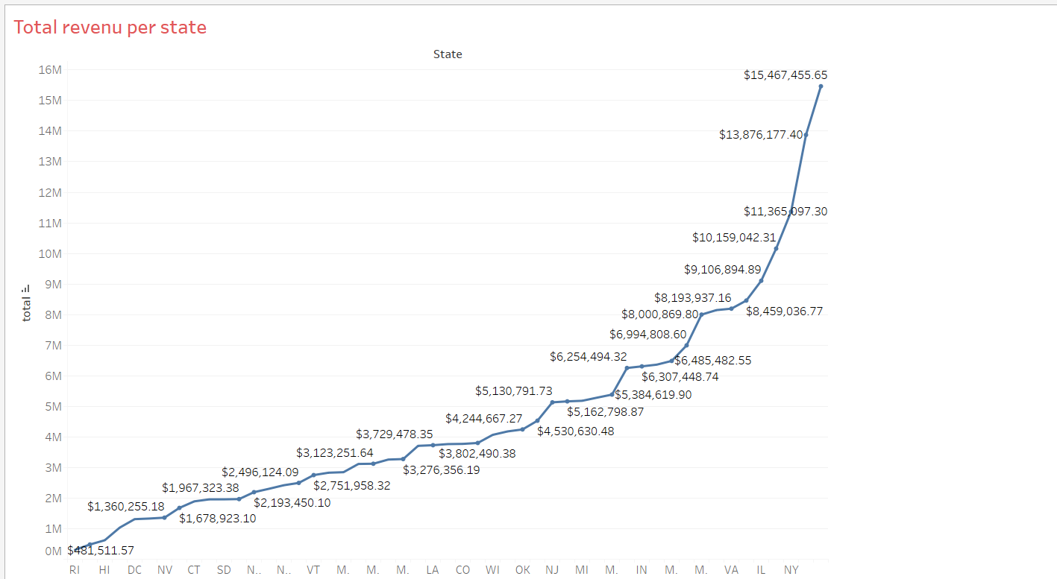
It shows the state wise total revenue of company.

Slide 4
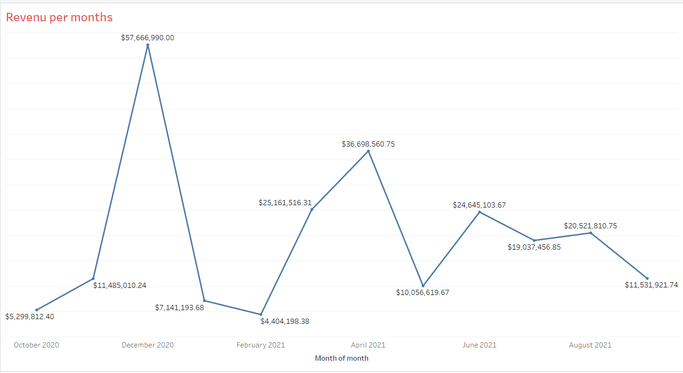
This graph shows revenue per months in a year.
In December and April total revenue goes increasing at higher level.
Rest of months having moderate revenue.

Slide 5
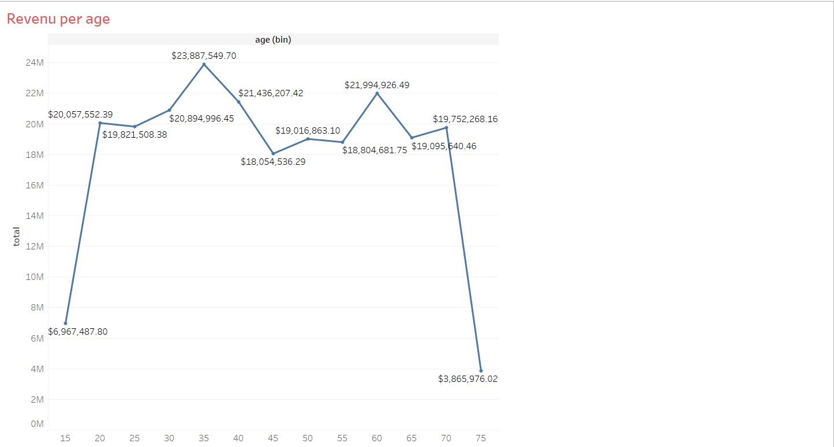
Revenue per age:
Total revenue is lower in age group of 15 and 75.
Age group between 20 to 70 have great revenue.
People having a age 30 to 40 spends more.

Slide 6
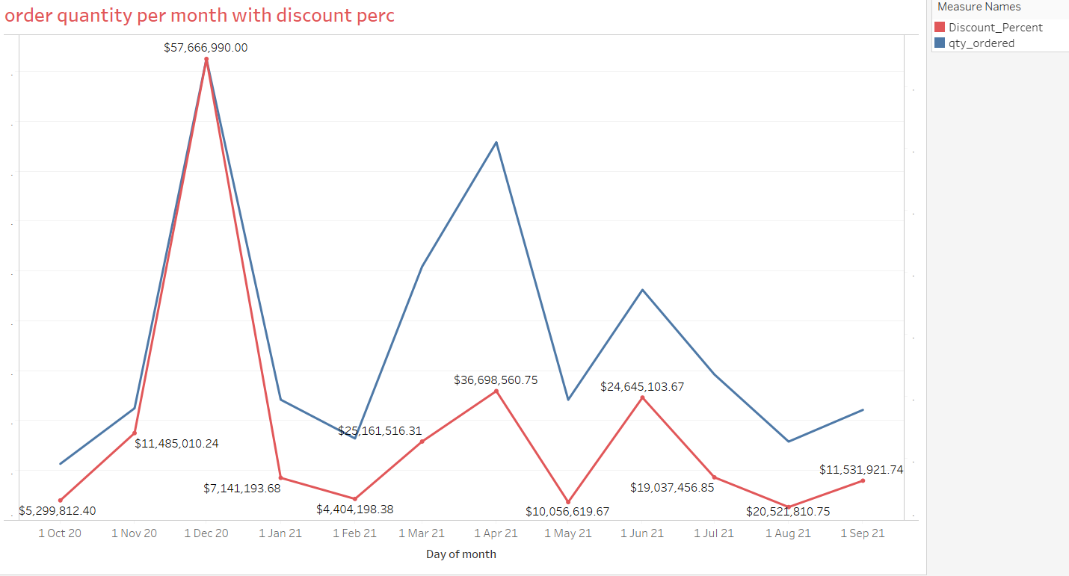
Order quantity and discount per month:
Quantity ordered are most in December and April months.
As discount increases order quantity also increases.

Slide 7
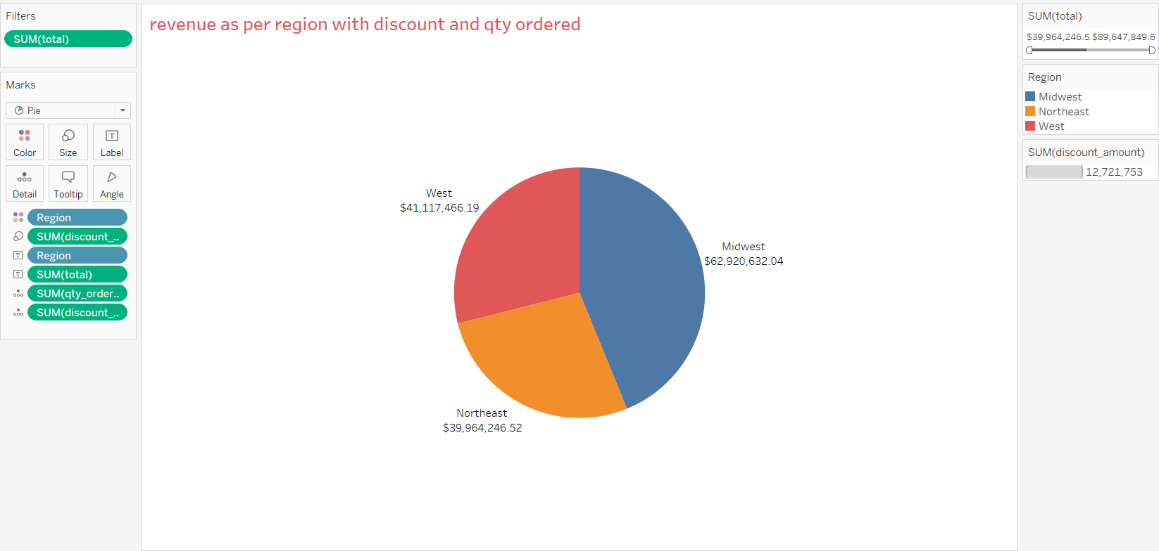
Revenue per region:
There is higher revenue from Midwest region than other region.
Discount price and order quantity also higher in Midwest region.

Slide 8
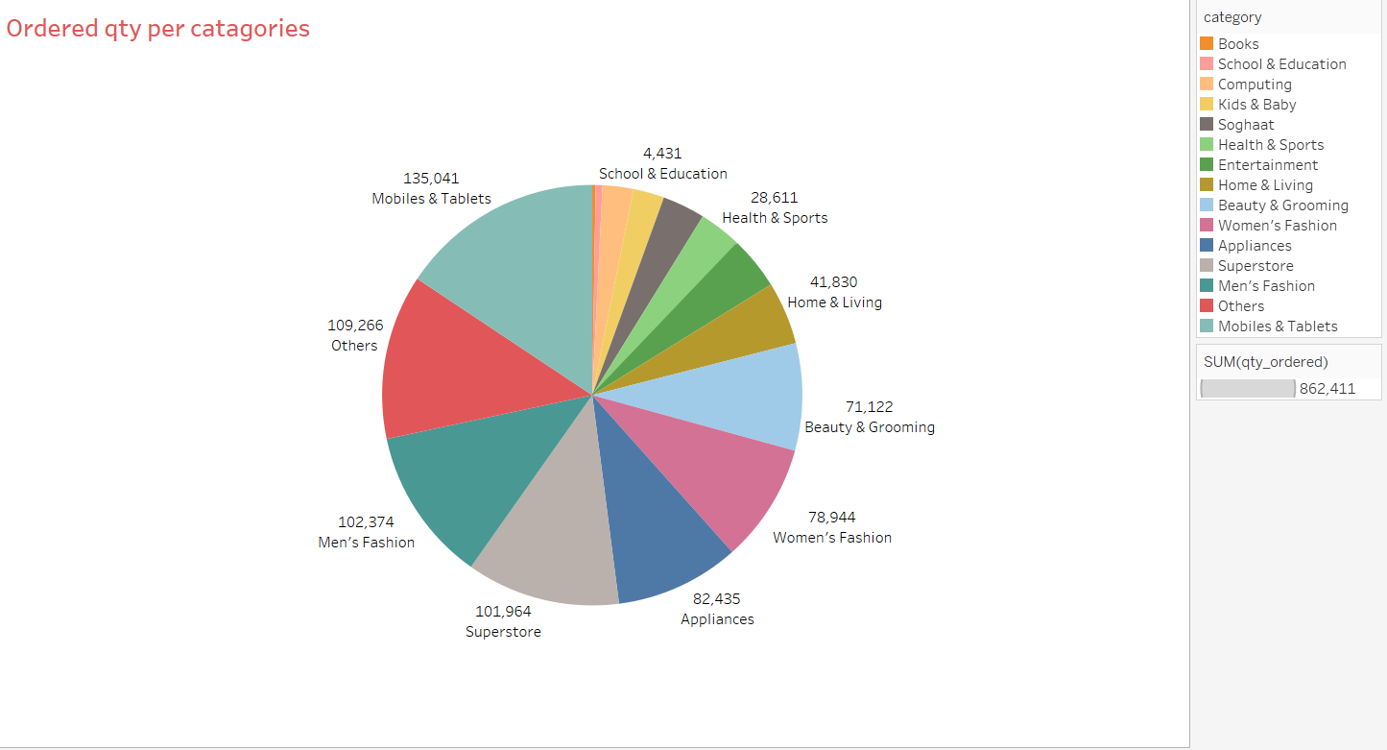
Order Quantity per categories:
Most of order quantities for mobiles, men's fashions and superstore.
Lack of orders for health and sports, school and educations.

Slide 9
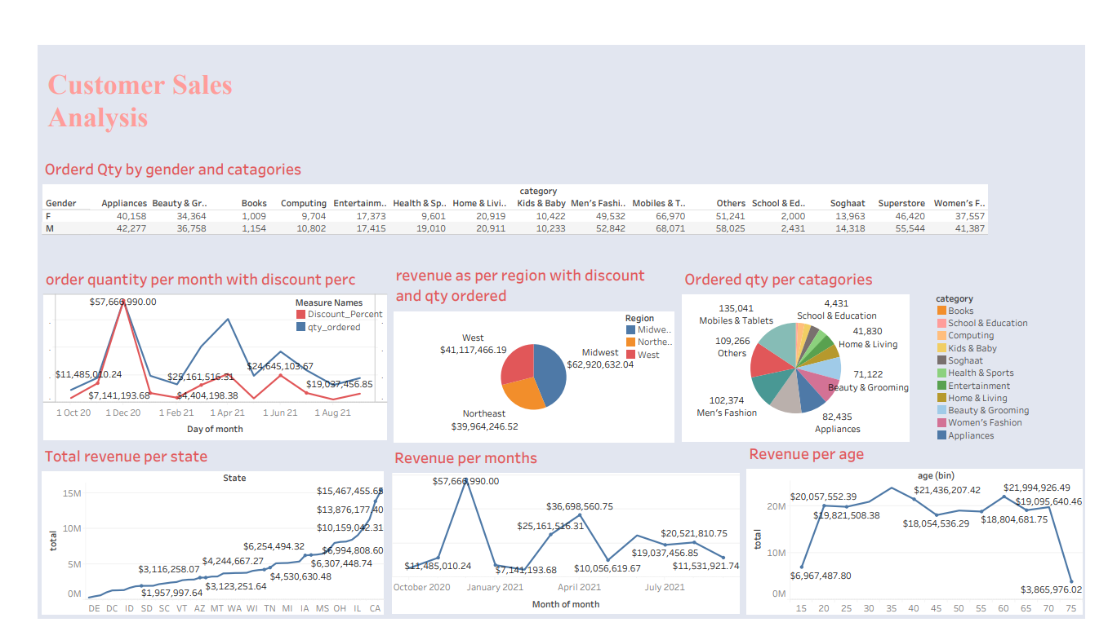
Dashboard for Customer sales analysis

Slide 10
Conclusion:
Dashboard is made to observe revenue of organization from customer sales.
Total revenue of industry is $23,36,50,194.43208.
Revenue get increases in December march and April months.
Most of revenue from age group 20 to 70 years.
As discount increases order quantity also increases.
Most of revenue from Midwest region.
Mobiles men’s fashions are sold in more quantities.

Slide 11
Thank You

